Slide 1
Image colorization
Digital Image Processing and Analysis Project
Luka Mucko, Filip Pankretić, Dominik Jambrović, Velimir KovaČIĆ, Filip Perković, Luka Glavinić
Assigned professor/assistant: dr. sc. Donik Vršnjak
FER 2023./2024.

Slide 2
Table of contents
1. Introduction
2. COCO 2017 dataset
3. Generative adversarial networks
4. Quality metrics
5. Experiment results
6. Comparison with prior work
7. Conclusion

Slide 3
Problem description and motivation
Input: grayscale image
Output: color image
Image colorization can be used for the restoration of historical images
Traditional methods require a lot of time and expertise
With advancements in deep learning, image colorization can be automatized

Slide 4
Prior work
Most traditional methods depend on user input
Scribble-Based Colorization
Deep learning methods:
Convolutional neural networks – Colorful Image Colorization
Generative adversarial networks – cGAN, wGAN

Slide 5
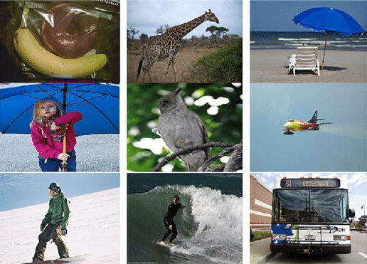
COCO 2017 dataset
Over 200 000 images
80 classes
We used:
Train set: approx. 120 000 images
Test set: approx. 40 000 images

Slide 6
Generative adversarial networks
Generator – generates images from random input vector
Discriminator – detects if an image is real or generated
Zero-sum game
Conditional GAN (cGAN) – conditional vector as input

Slide 7
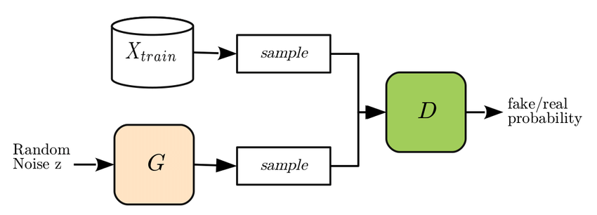
Generative adversarial networks

Slide 8
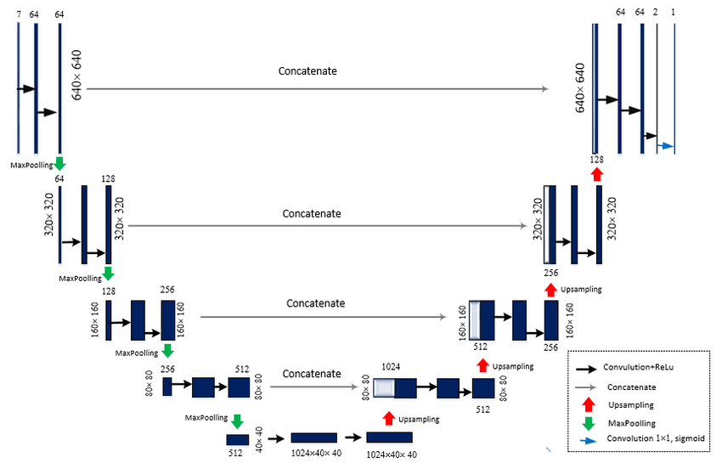
Generative adversarial networks
We used:
Generator: U-Net
Discriminator: CNN

Slide 9
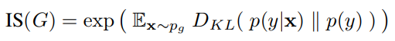

Quality metrics
Inception Score (IS)
Fréchet Inception Distance (FID)

Slide 10
Experiments

Slide 11
Experiment setup
Input images were converted into CIELAB color space
Generator gets grayscale image (L component) as input, generates A and B components
Discriminator detects if the image is real or generated
Model training:
200 epochs
Optimizer: Adam

Slide 12
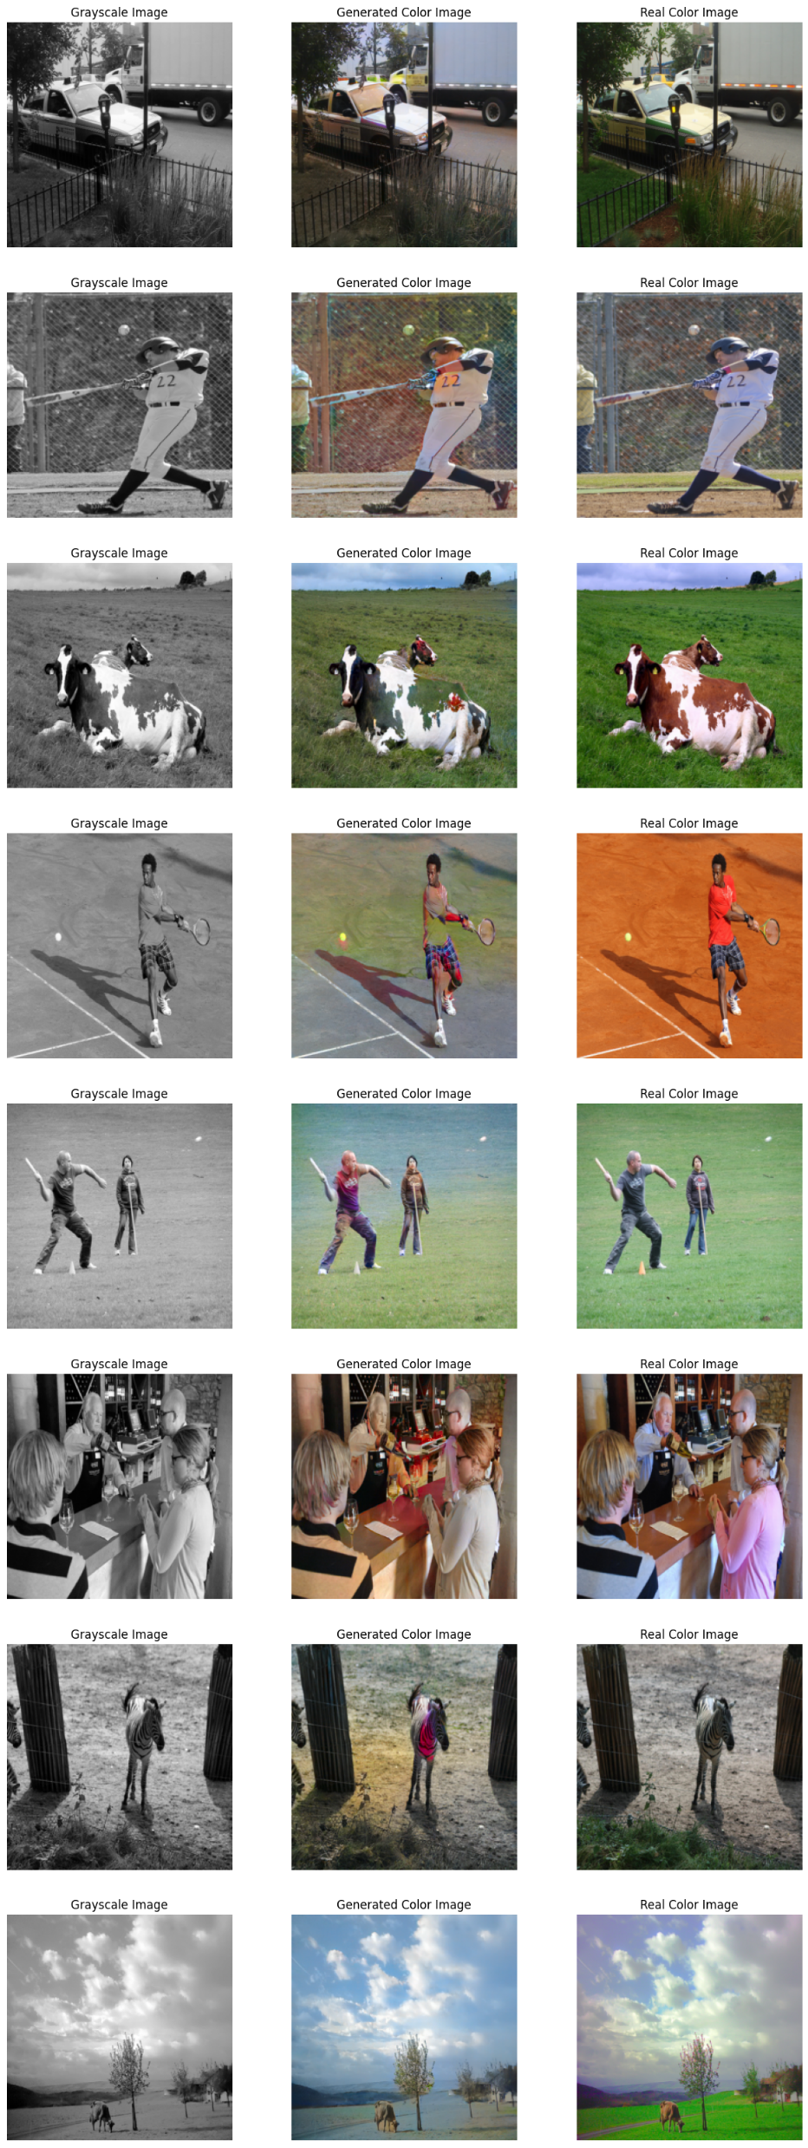
Experiment results

Slide 13
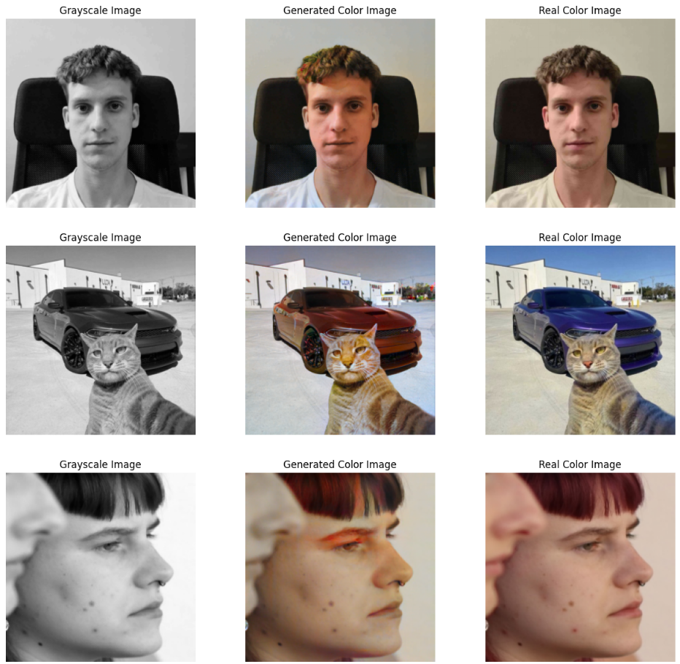

Experiment results

Slide 14
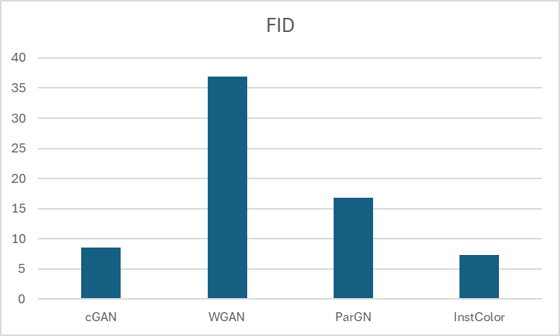
Comparison with prior work - FID

Slide 15
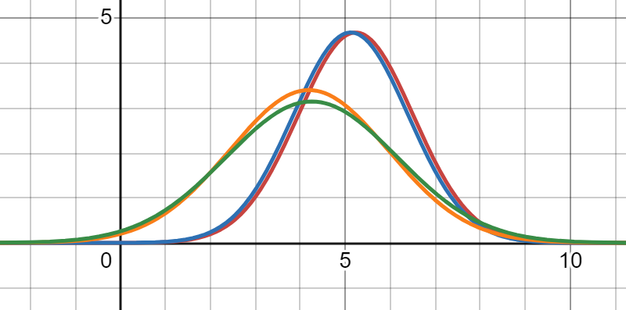
Comparison with prior work - IS
Blue (Real), Red (Generated) - cGAN
Green (Real), Orange (Generated) - WGAN

Slide 16
Conclusion
cGAN architecture can be used to successfully colorize images
Quality of colorization depends on the used dataset
Future work:
Train model on bigger datasets (ImageNet)
Try different architectures (WGAN, diffusion models)

Slide 17
Thanks for your attention!

